Slide 1

Customer Churn Analysis
Understanding churn patterns through data science and interactive visualization

Slide 2





Project Workflow
Data Cleaning
Pandas preprocessing and transformation
EDA
Exploratory analysis and insights
ML Model
RandomForest prediction training
Power BI
Interactive visualization dashboard

Slide 3

Dataset Overview
7,043
Key Features
Demographics: Gender, SeniorCitizen, Tenure
Total Customers
Services: Internet, Security, Streaming
20
Billing: MonthlyCharges, Contract type
Features
Target: Churn (Yes/No)
Demographics, services, billing

Slide 4

Data Preparation Challenges
Missing Values
Type Conversion
Encoding Issues
TotalCharges contained blank entries requiring imputation
TotalCharges stored as string, converted to float
Mixed categorical encodings standardized via encoders.pkl

Slide 5

Critical Churn Insights
Contract Type
Month-to-month customers show highest churn rate
Payment Method
Electronic check users churn most frequently
Tenure Risk
0-3 months customers churn significantly
Pricing Impact
Higher MonthlyCharges correlate with churn

Slide 6

Machine Learning Model
Model Architecture
77.7%
58%
Algorithm: RandomForestClassifier
Split: 70-30 train-test
Accuracy Score
Churn Recall
Preprocessing: Label encoding
Output: .pkl deployment files
Identifying at-risk customers

Slide 7



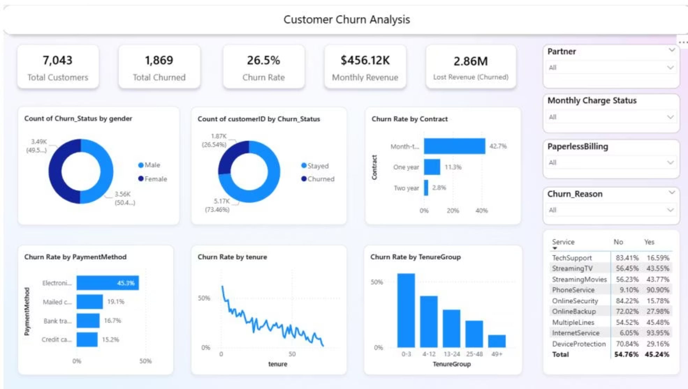
Power BI Dashboard Metrics
26.5%
42.7%
50%
Churn Rate
Month-to-Month
Early Tenure
1,869 of 7,043 customers churned
Highest churn by contract type
0-3 months churn rate

Slide 8

Revenue Impact Analysis
$456K
Service Adoption
High churn services:
Monthly Revenue
No TechSupport: 83.4% churn
$2.86M
No OnlineSecurity: 84.2% churn
No OnlineBackup: 72% churn
Lost Revenue
From churned customers

Slide 9
Strategic Recommendations
01
02
03
Promote Long-Term Contracts
Improve Payment Experience
Target Early-Tenure Customers
Incentivize migration from month-to-month to annual plans
Introduce smoother alternatives to electronic check
Personalized onboarding and welcome benefits for <6 months
04
05
Strengthen Add-on Services
Retain High-Revenue Customers
Feature OnlineSecurity, TechSupport in retention offers
Focus strategies on high MonthlyCharges segments

